Slide 1
Setting up Squish

Slide 2
Setting up Squish
Installing Squish on Windows
Go to the Qt Squish evaluation/download page and request an evaluation if you do not already have a Squish license. The evaluation currently offered by Qt is typically a 10-day business evaluation. Qt Documentation
After Qt approves the evaluation, sign in to the Qt Customer / QA Software Portal and download the Squish binary installer. Qt Documentation
Choose the package according to what you want to automate:
  Squish for Web → websites/web applications
  Squish for Qt → Qt desktop applications
  Squish for Windows → Windows desktop applications such as WPF, WinForms, MFC
  Other editions exist for Java, Android, etc. Qt Documentation
Run the downloaded installer, for example:
squish-9.x.x-....exe

Slide 3
Setting up Squish
Follow the installation wizard:
  Accept the license agreement
  Select installation directory
  Configure your Squish license/evaluation
  Keep Squish IDE selected
  Keep documentation/examples if you want them
  Click Next → Install
The exact wizard screens depend on the Squish edition you downloaded. Qt Documentation
After installation, open:
<SQUISH_INSTALL_FOLDER>\squishide.exe
For example:
C:\Squish\squishide.exe
Qt confirms that squishide.exe is the executable used to start the Squish IDE on Windows.

Slide 4
Licensing and configuration
Squish licensing options
Squish 9.2 currently supports three licensing methods:
For an evaluation version, you normally use a Local License Key from the Qt Customer Portal. Evaluation users generally do not use FLS or QLS.
License type | Usually used for
Local License Key | Trial/evaluation users
Squish Floating License Server (FLS) | Companies sharing licenses between users/machines
Qt License Server (QLS) | Newer centralized Qt/Squish licensing

Slide 5
Licensing and configuration
2. Configure an evaluation/trial license
Log in to the Qt Customer Portal and go to:
My Licenses
↓
Squish License
↓
License Details
↓
Copy License Key
Then launch the Squish installer. On the licensing screen select:
Local License Key
Paste the license key and click:
Next
Squish validates the key before continuing with installation. Qt Documentation
On Windows, the local license information is normally stored under:
%HOMEDRIVE%%HOMEPATH%\.squish-license
For example:
C:\Users\Anurag\.squish-license and complete the installation

Slide 6
Configuring the Application Under Test
For a web application, configuring the AUT in Squish is a little different from configuring a desktop .exe. In Squish for Web, you mainly configure the browser, then start that browser with the application URL. Qt’s current Squish 9.2 documentation recommends this flow.
1. Configure the browser
Open Squish IDE and go to:
Edit
→ Server Settings
→ Browser
Select the browser you want to automate, for example:
Google Chrome
Firefox
Microsoft Edge
Safari
For Chrome/Chromium and Firefox, Squish may ask you to install its browser integration/extension. If the browser executable is not detected automatically, specify its path manually. Qt Documentation
For example, on Windows Chrome may be located at:
C:\Program Files\Google\Chrome\Application\chrome.exe

Slide 7
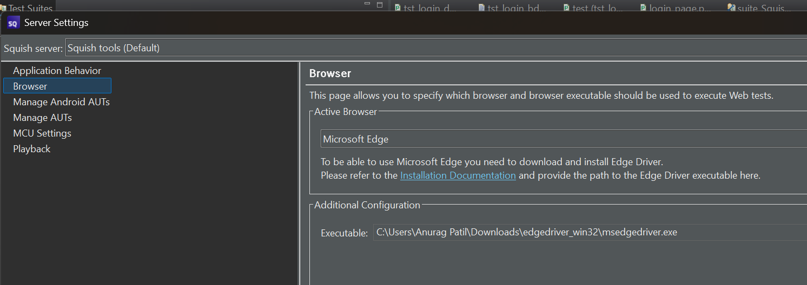
Configuring the Application Under Test

Slide 8
Configuring the Application Under Test
3. Create a Web test suite
Go to:
File
→ New Squish Test Suite
Select a scripting language, for example:
Python
Then select the toolkit:
Web
4. For a normal website, don't configure the URL as a desktop AUT
For something like:
https://www.example.com
you usually don't register example.com as an AUT executable.
Instead, Squish starts a supported browser and loads your URL.
For example:
def main():
startBrowser("https://www.example.com")

Slide 9
The Squish IDE
IDE Area | Purpose
Test Suites View | Shows your test suites, test cases, shared scripts, and resources
Test Case Editor | Where you write and edit Python, JavaScript, Perl, Ruby, or Tcl test scripts
Application Objects View | Shows symbolic names and object mappings used to identify UI elements
Control Bar / Toolbar | Start recording, run tests, stop execution, debug, and inspect
Test Results View | Displays PASS, FAIL, WARNING, logs, screenshots, and verification results
Object Spy | Lets you inspect UI elements and their properties
Server Settings | Configure browser, AUT, Squish Server, hooks, and other environment settings
Preferences | Configure IDE behavior, editor settings, scripting, and general Squish options

Slide 10
The Squish IDE
IDE Area | Purpose
Test Suites View | Shows your test suites, test cases, shared scripts, and resources
Test Case Editor | Where you write and edit Python, JavaScript, Perl, Ruby, or Tcl test scripts
Application Objects View | Shows symbolic names and object mappings used to identify UI elements
Control Bar / Toolbar | Start recording, run tests, stop execution, debug, and inspect
Test Results View | Displays PASS, FAIL, WARNING, logs, screenshots, and verification results
Object Spy | Lets you inspect UI elements and their properties
Server Settings | Configure browser, AUT, Squish Server, hooks, and other environment settings
Preferences | Configure IDE behavior, editor settings, scripting, and general Squish options

Slide 11
Thank You

